Slide 1





Process Screenshots
GEP’s Onboarding and Offboarding As-Is Process

Slide 2
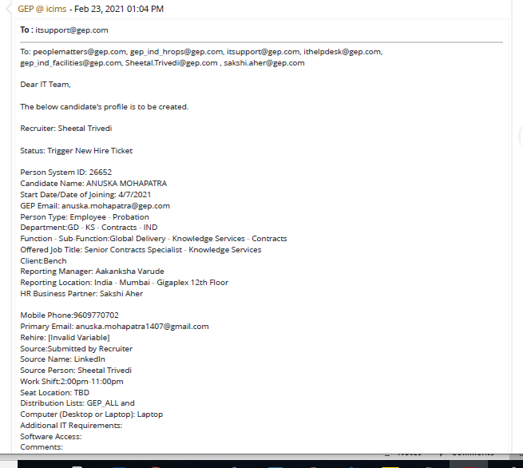
NHOP User Creation in Active Directory
Click on Unassigned Queue and Read NHOP Ticket
NHOP

Slide 3

NHOP User Creation in Active Directory
Open AD application (Active Directory User and computer)
NHOP

Slide 4
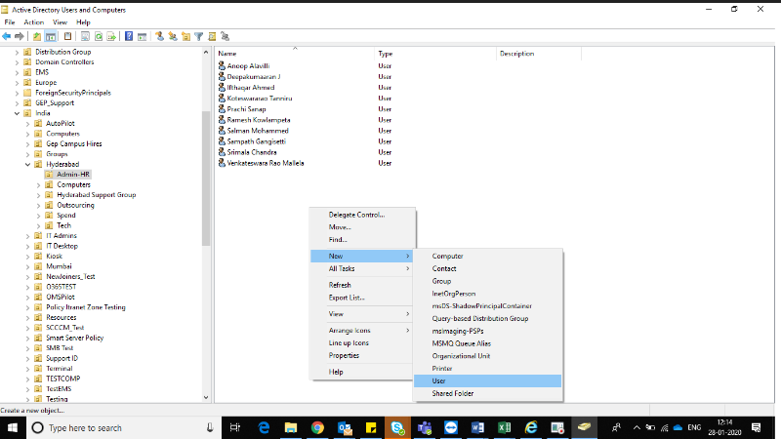
NHOP User Creation in Active Directory
Right Click and Create New User
NHOP

Slide 5
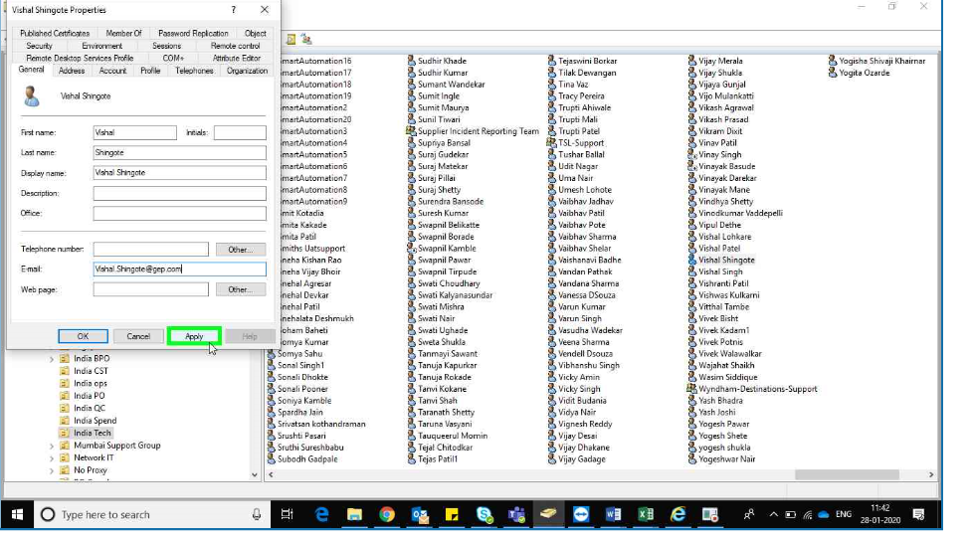
NHOP User Creation in Active Directory
New Object User window will open Enter User Logan name
NHOP

Slide 6
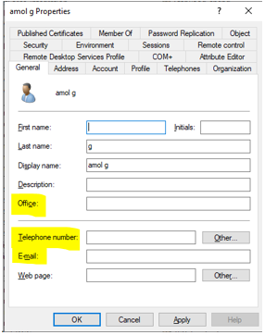
NHOP User Creation in Active Directory
Click on Add Office Name, Telephone number, Email in Textbox and Click Apply
NHOP

Slide 7
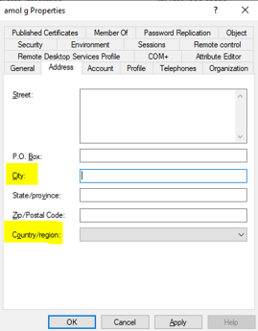
NHOP User Creation in Active Directory
Click on Address tab, Enter City and country/region Click on Apply Button
NHOP

Slide 8
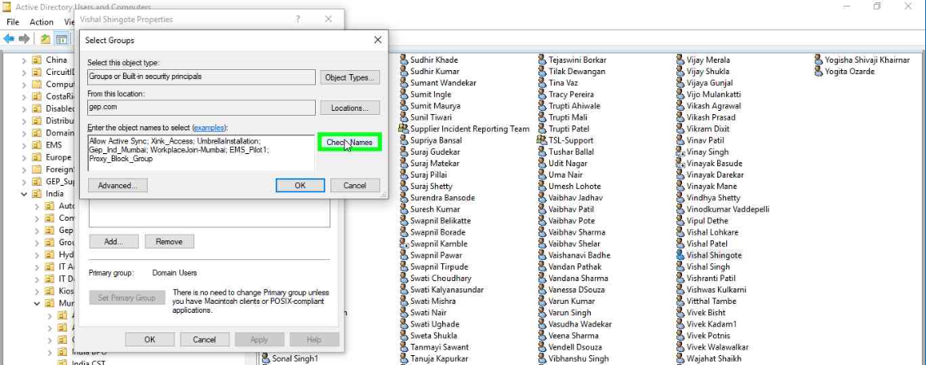
NHOP User Creation in Active Directory
Click on Telephone tab, Enter Mobile Number and Click on Apply Button
NHOP

Slide 9
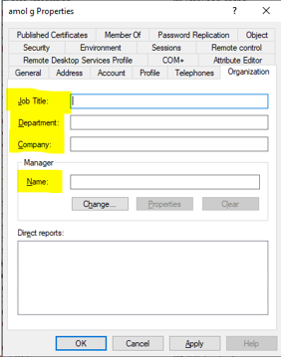
NHOP User Creation in Active Directory
Click on Organization and Add Job Title, Department, Company, Manager Name Click on OK Button
NHOP

Slide 10
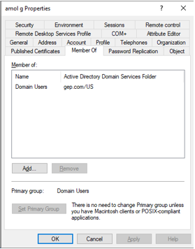
NHOP User Creation in Active Directory
Click on Check Attribute Editor Add SMIP and SIP
NHOP

Slide 11
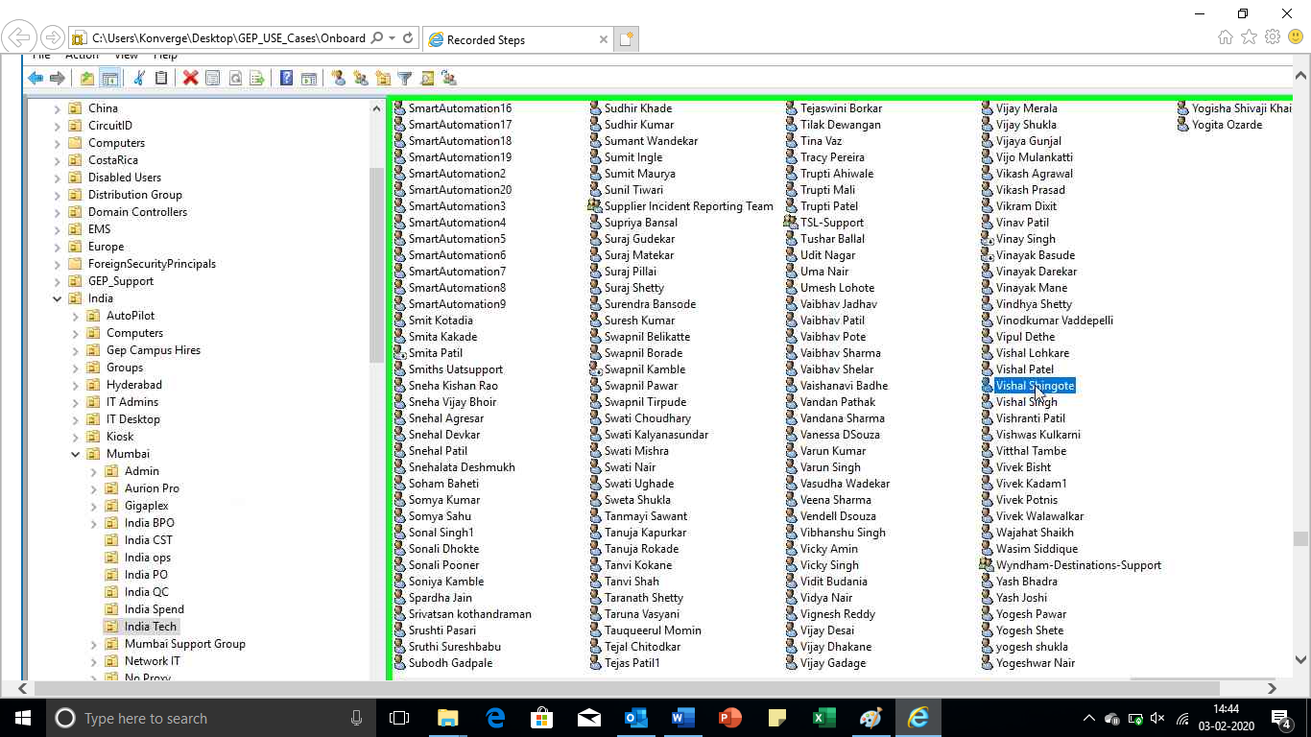
NHOP User Creation in Active Directory
Right Click on User and Click on Disable
NHOP

Slide 12
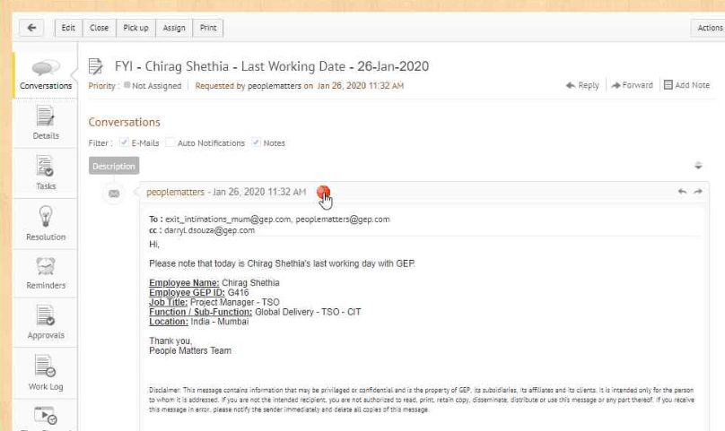
LWD User Disable in Active Directory
Manage Engine LWD request screenshot
LWD

Slide 13
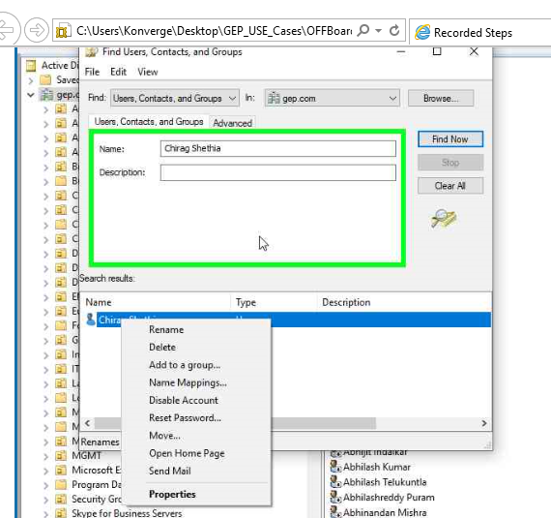
LWD User Disable in Active Directory
Check for User in directory
LWD

Slide 14
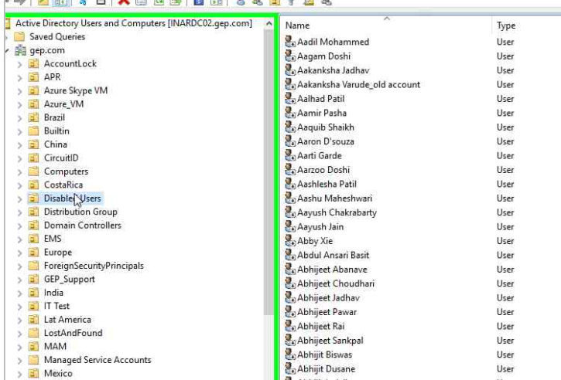
LWD User Disable in Active Directory
Check for Disable Users in directory
LWD

Slide 15
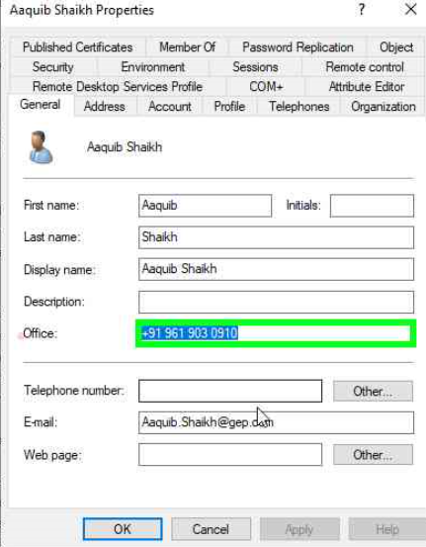
LWD User Disable in Active Directory
Click on General Tab and remove office, Telephone number & E-mail field
LWD

Slide 16
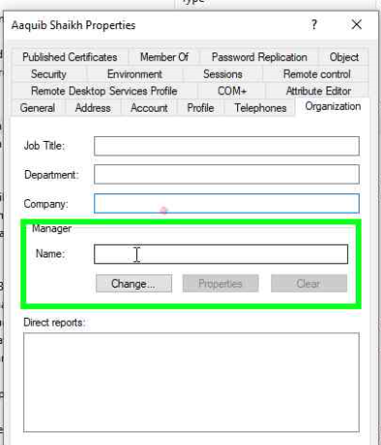
LWD User Disable in Active Directory
Select organization tab and remove Job title, Department, Company & Manager field
LWD

Slide 17
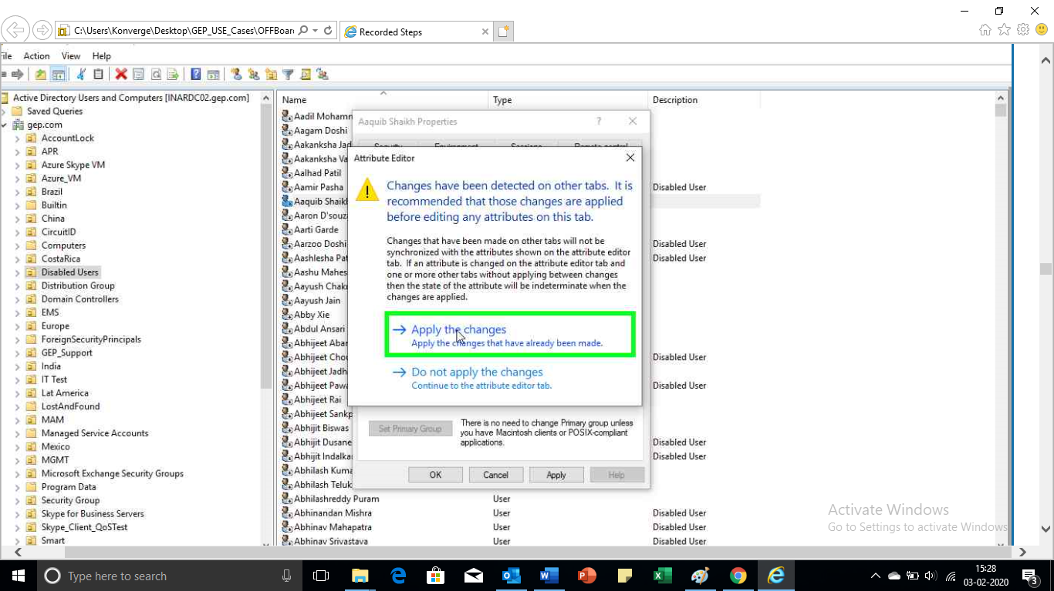
LWD User Disable in Active Directory
Select Member of Tab and remove from all group and click Apply
LWD

Slide 18
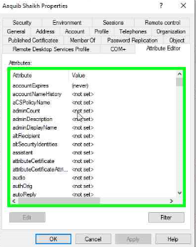
LWD User Disable in Active Directory
Select Attribute editor tab and remove "proxyAddresses" & "msExchUCVoiceMailSettings" entries and click Apply & OK
LWD

Slide 19
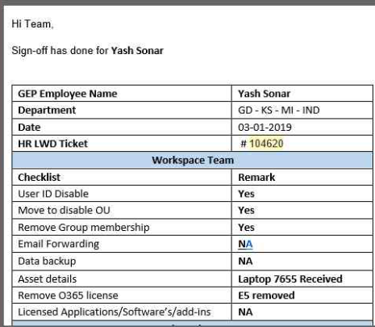
LWD User Disable in Active Directory
Select Revert to HR for Deactivation
LWD : The item box in green would be updated by automation for LWD Ticket

Slide 20
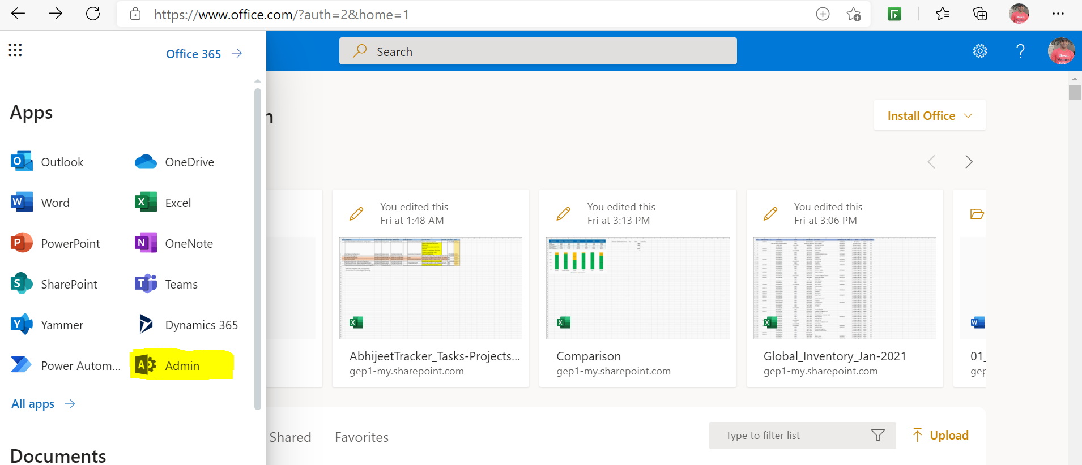
MFA (Multifactor Authentication)
This feature is enabled by service desk support during employee onboarding as a mandatory process for two factor authentications. Login to Portal.office.com/admin.microsoft.com. Select Admin portal.
MFA

Slide 21
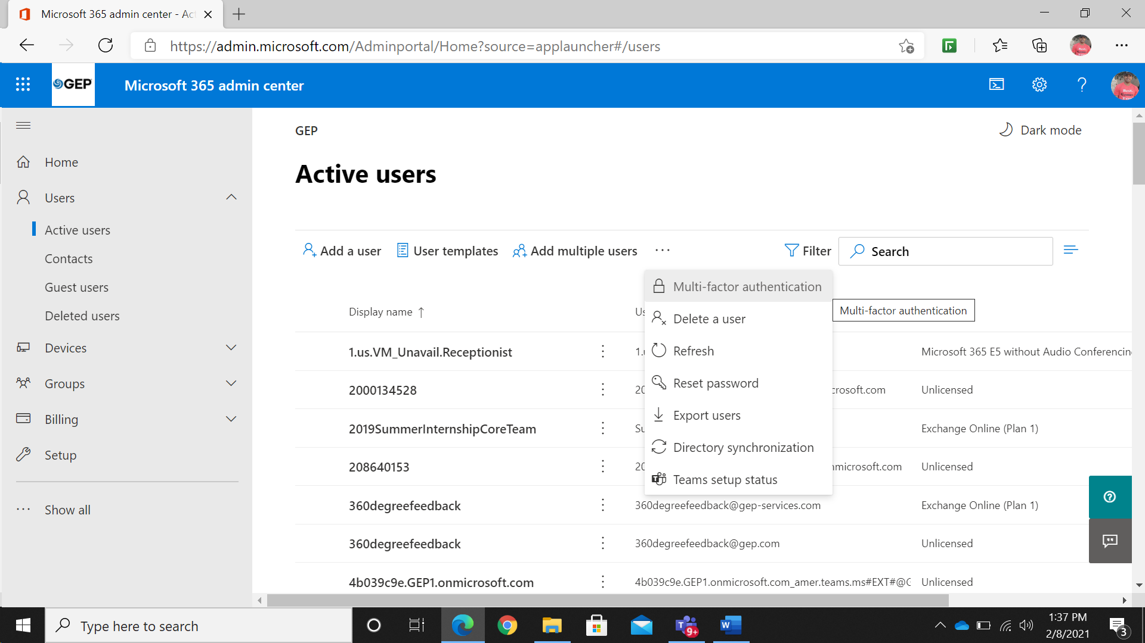
MFA (Multifactor Authentication)
Click on Multi-factor authentication.
MFA

Slide 22
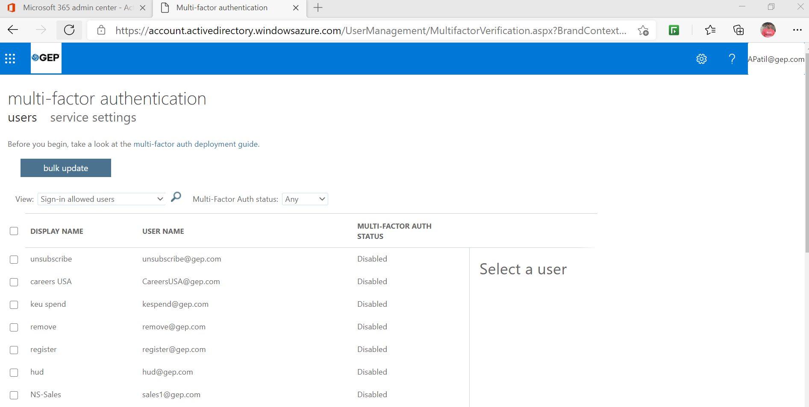
MFA (Multifactor Authentication)
New tab will open as below. Search the employee name and click on Enable, a confirmation pop-up window will appear. Click on “enable multi-factor auth” to enable the setting.
MFA

Slide 23
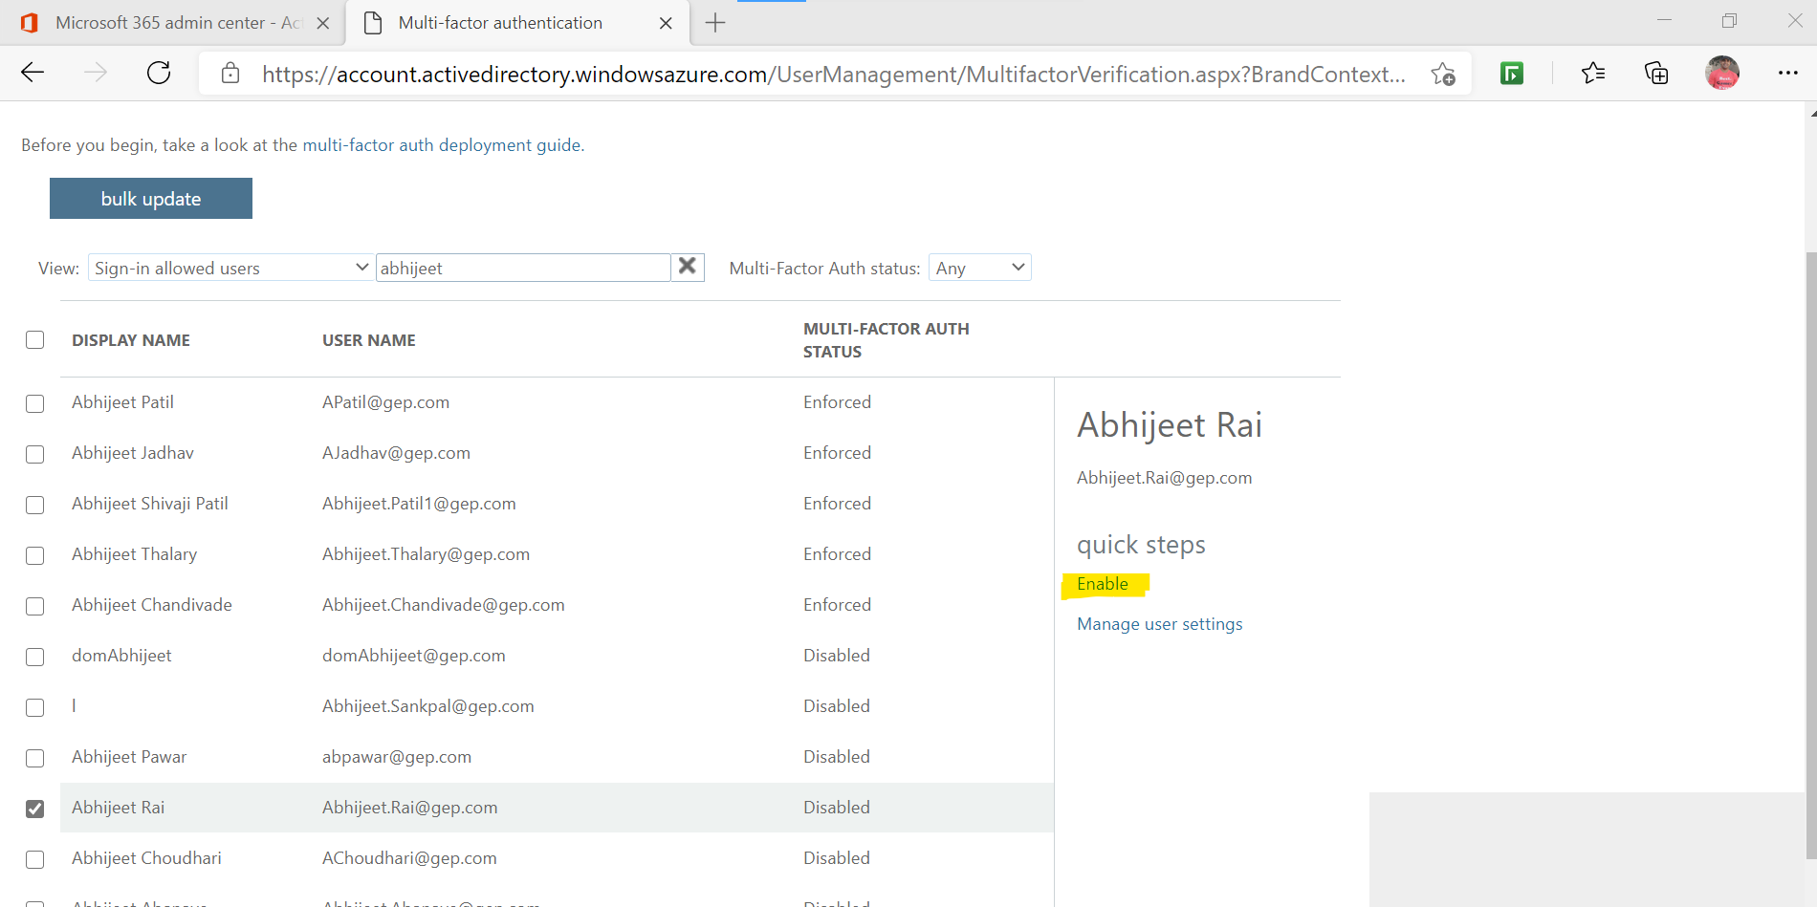
MFA (Multifactor Authentication)
New tab will open as below. Search the employee name and click on Enable, a confirmation pop-up window will appear. Click on “enable multi-factor auth” to enable the setting.
MFA

Slide 24
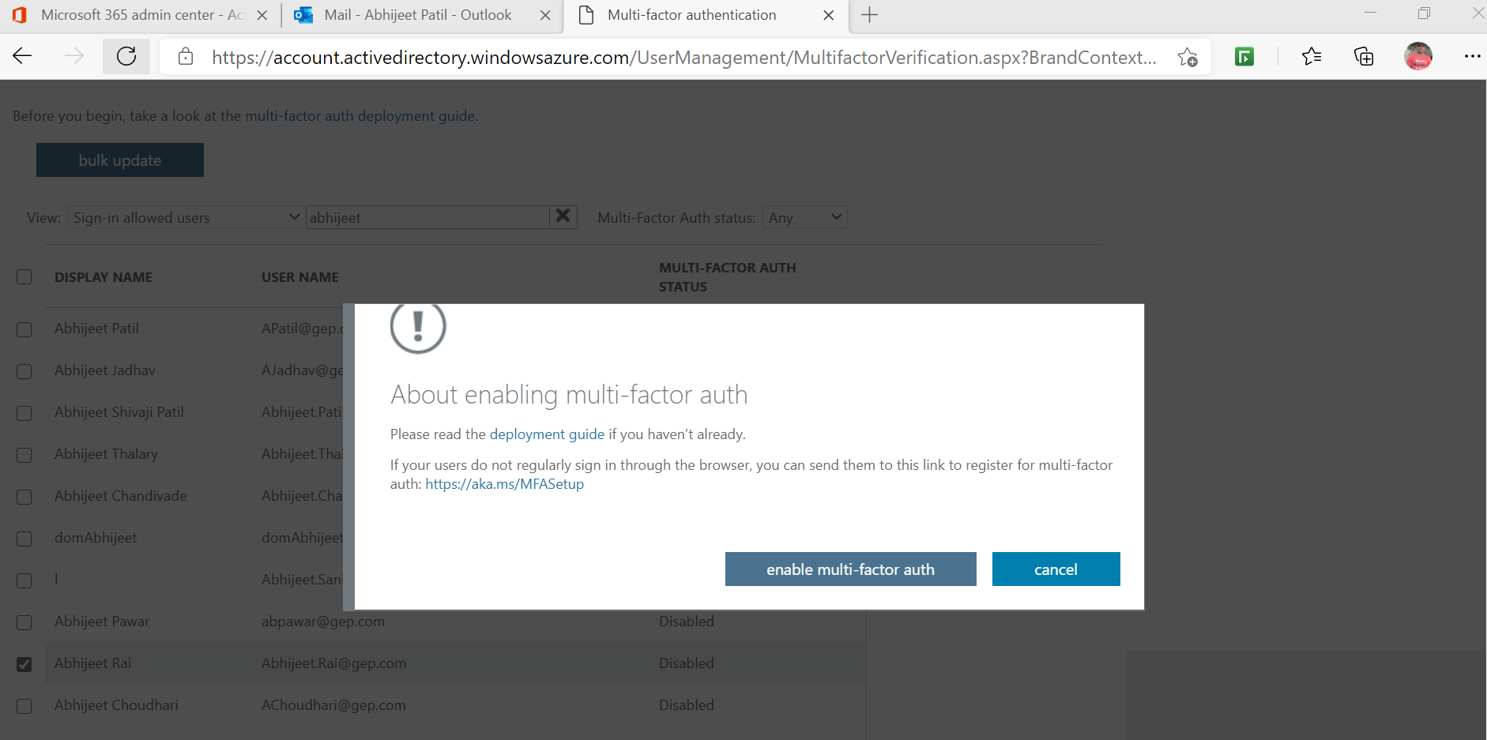
MFA (Multifactor Authentication)
New tab will open as below. Search the employee name and click on Enable, a confirmation pop-up window will appear. Click on “enable multi-factor auth” to enable the setting.
MFA

Slide 25
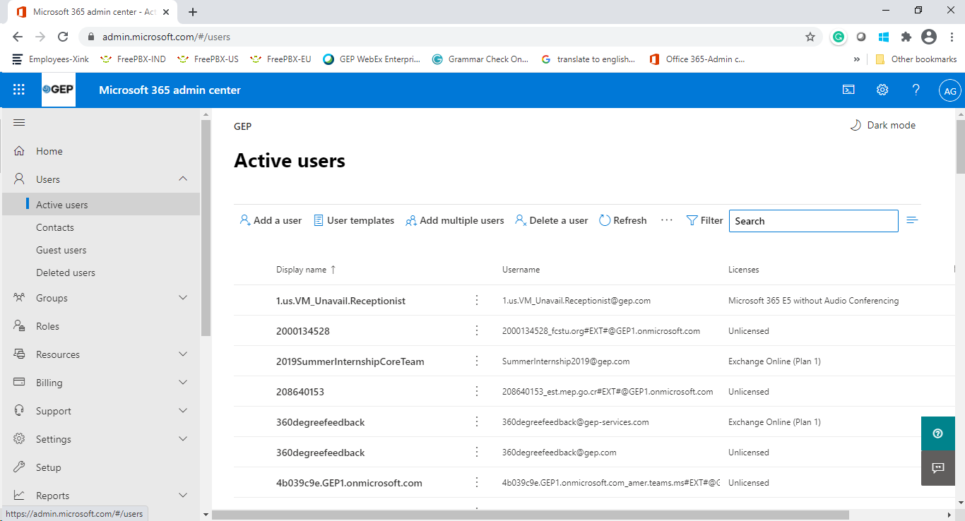
Enable E5 and Microsoft Teams License
Login to: admin.microsoft.com
Under users click on Active users
Search for the users whom you want to enable E5/MS Teams license.
Enable E5 and Microsoft Teams License

Slide 26
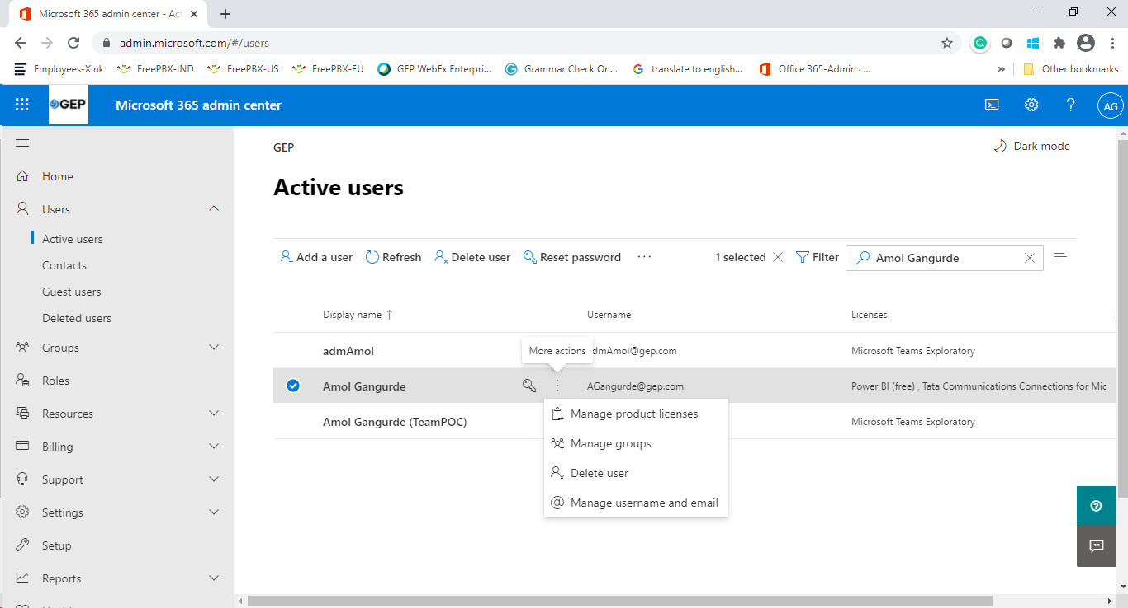
Enable E5 and Microsoft Teams License
If the target user found, Click on 3 dots (more option) and select “Manage product licenses”
Enable E5 and Microsoft Teams License

Slide 27
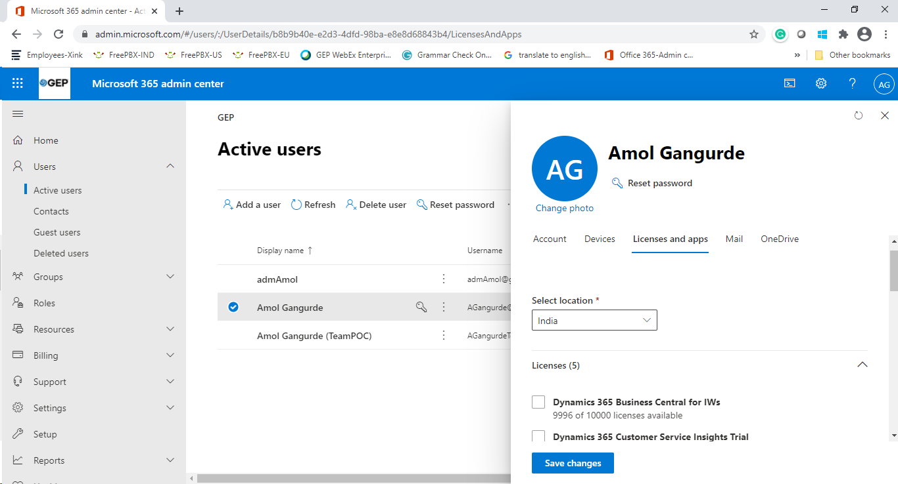
Enable E5 and Microsoft Teams License
Under “Licenses and apps” tab, Select location (user joining location).
Enable E5 and Microsoft Teams License

Slide 28
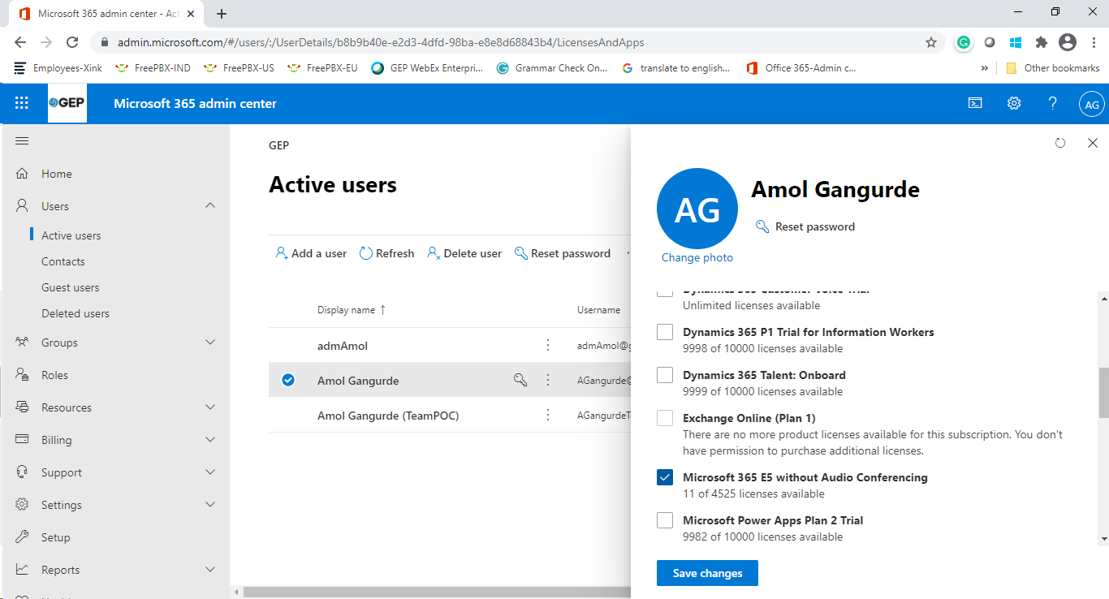
Enable E5 and Microsoft Teams License
Then scroll down further until you see “Microsoft 365 E5 without Audio Conferencing” option. Click the check box to enable the license.
Enable E5 and Microsoft Teams License

Slide 29
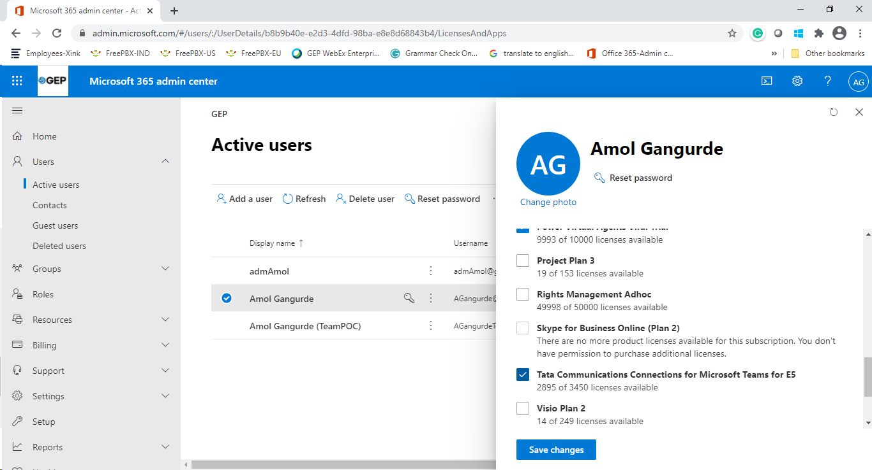
Enable E5 and Microsoft Teams License
Scroll down further till you see “Tata Communications Connections for Microsoft Teams for E5” check the box to enable the license
Note: The Microsoft Teams license is applicable only for Manager and above.
Enable E5 and Microsoft Teams License

